Slide 1
Course: Embedded System Design and Modeling Topic: Finite State Machine
Class at Lewis University
Yue Cao Purdue University, ECE yuecao@purdue.edu

Slide 2
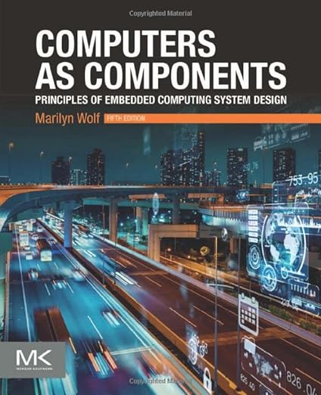


Resources
Fifth Edition, 2022
Supporting slides online
Second Edition, 2017
eBook online
2009
Supporting slides online
general topics, hardware & software
system level design

Slide 3
What is an Embedded System?

Slide 4
What is an Embedded System?
any device that includes a programmable computer, but is not itself intended to be a general-purpose computer
less visible computers
application specific
and tightly constrained by different requirements

Slide 5
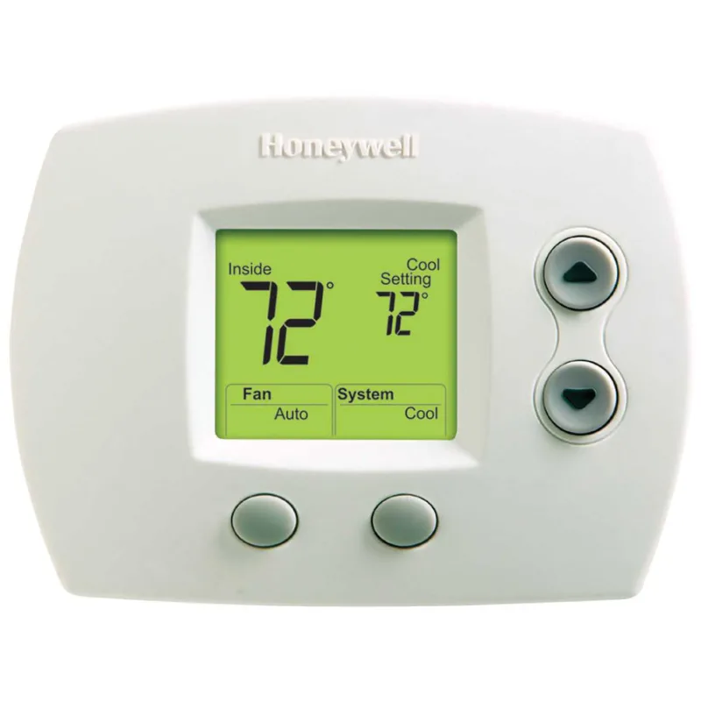


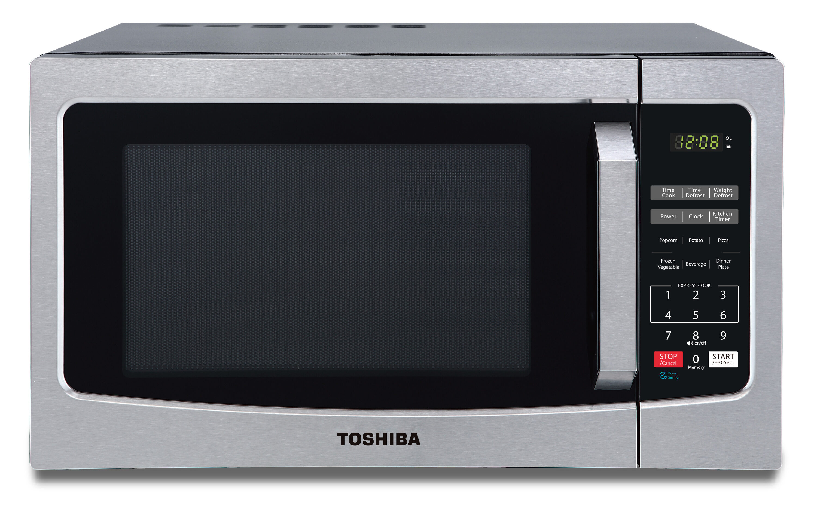
Are they embedded systems?

Slide 6


Are they embedded systems?

Slide 7


Design Philosophy
Hardware/Software CoDesign
display
processor
hardware
GPS receiver
memory
panel I/O
software
user interface
database search
route planning
rendering

Slide 8

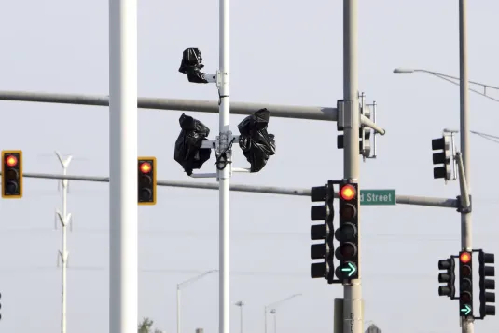

A Topic in Software Design
How do we organize multiple events in code?

Slide 9
A Topic in Software Design
How do we organize multiple events in code?
One Solution for All: Finite State Machine

Slide 10
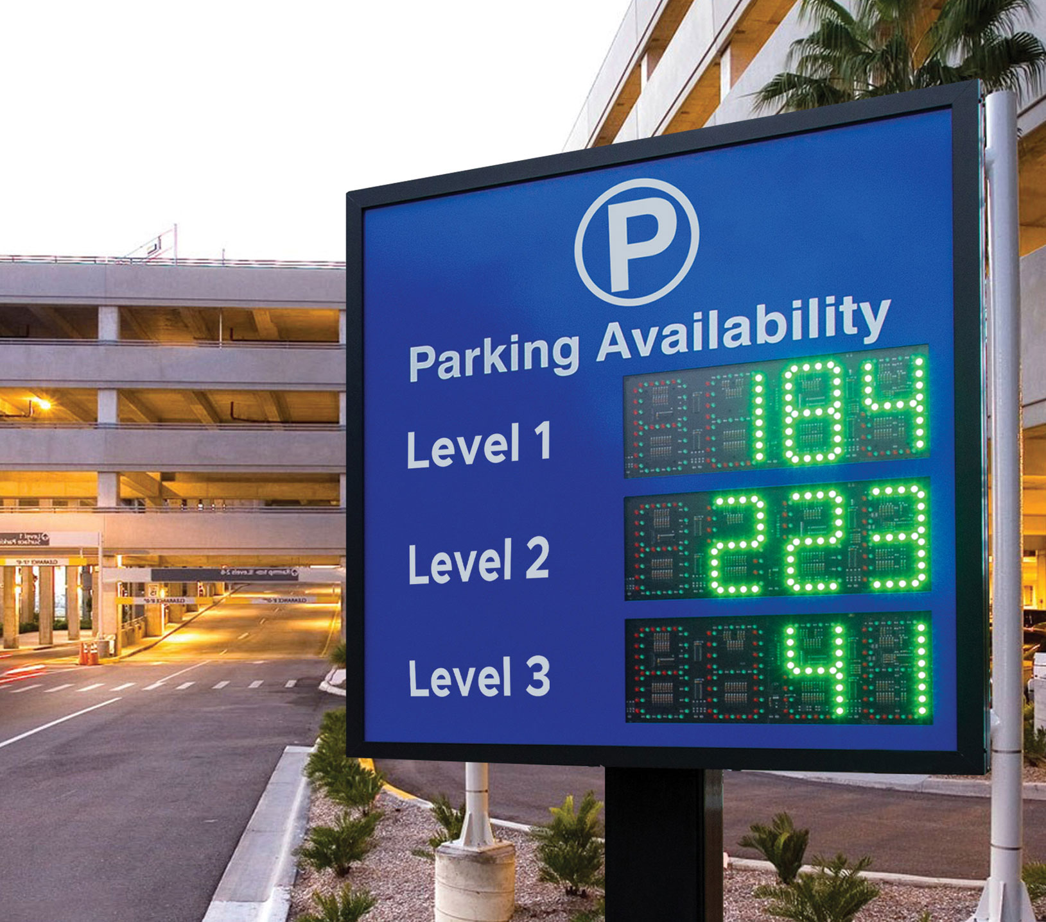
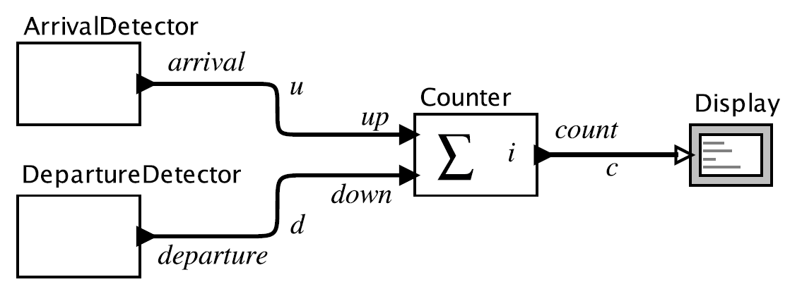
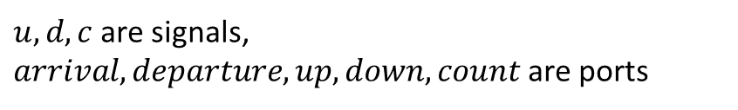
Finite State Machine
Start with a basic example
$u, d, c$are signals,
$arrival, departure, up, down, count$are ports

Slide 11
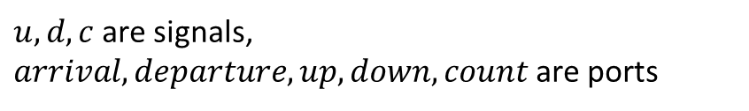
Finite State Machine
Represent it in “States”
If we have M parking spots,
then the display need to show {0, 1, 2, … ,M}.
We call {0, 1, 2, … ,M} as the states of the system.
$u, d, c$are signals,
$arrival, departure, up, down, count$are ports

Slide 12
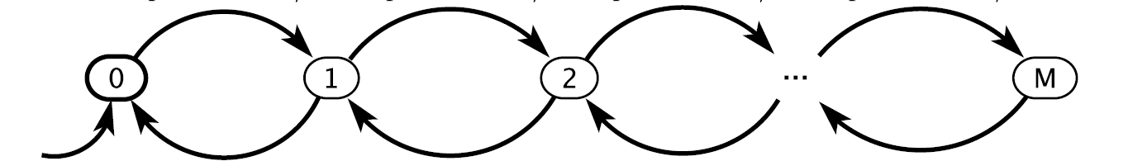
Finite State Machine
Represent it in “States”
If we have M parking spots,
then the display need to show {0, 1, 2, … ,M}.
We call {0, 1, 2, … ,M} as the states of the system.
$u, d, c$are signals,
$arrival, departure, up, down, count$are ports
Draw in a graph:
System transits from one state to another. At each time step, one car arrivals or departs, or both happen, or neither happen

Slide 13
Finite State Machine

Slide 14
Finite State Machine
Configure Transitions
We know what are the “States” now.
Then what about these transition lines?

Slide 15
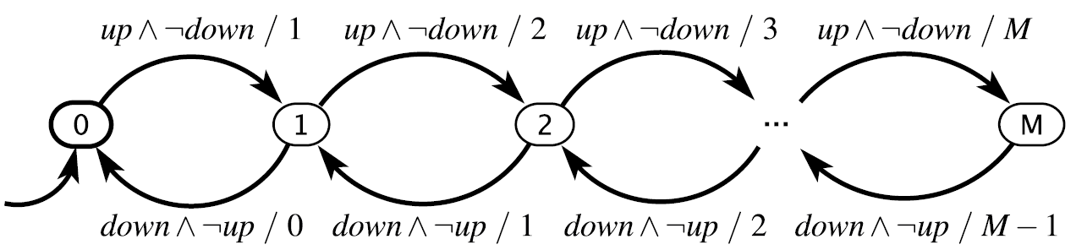
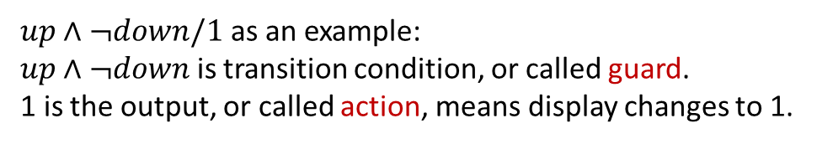
Finite State Machine
Configure Transitions
We know what are the “States” now.
Then what about these transition lines?
$up∧¬down/1$ as an example: $up∧¬down$ is transition condition, or called guard. 1 is the output, or called action, means display changes to 1.

Slide 16
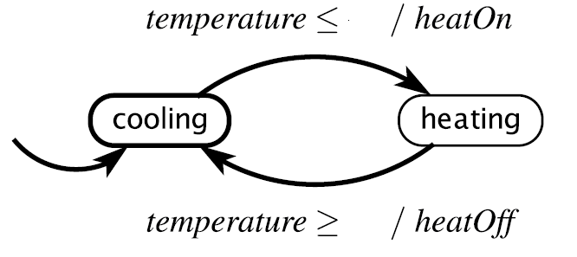
Finite State Machine
Let’s see another example
60
80
States? Guard? Action?

Slide 17
Finite State Machine
Let’s see another example
60
80
States: {cooling, heating} Guard? Action?

Slide 18
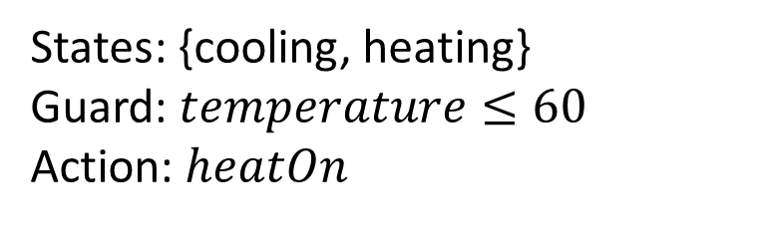
Finite State Machine
Let’s see another example
60
80
States: {cooling, heating} Guard: $temperature≤60$ Action: $heatOn$

Slide 19
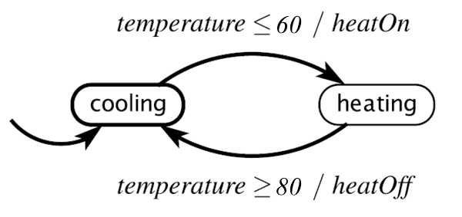
Finite State Machine
We just used graphs to organize events and their transitions.
They are examples of Finite State Machine
Definition
state machine a model of a system with discrete dynamics that at each reaction maps valuations of the inputs to valuations of the outputs, where the map may depend on its current state
finite state machine a state machine where the set States of possible states is finite.

Slide 20
Finite State Machine
We just used graphs to organize events and their transitions.
They are examples of Finite State Machine
Definition
state machine a model of a system with discrete dynamics that at each reaction maps valuations of the inputs to valuations of the outputs, where the map may depend on its current state
finite state machine a state machine where the set States of possible states is finite.

Slide 21
Finite State Machine
We just used graphs to organize events and their transitions.
They are examples of Finite State Machine
Definition
state machine a model of a system with discrete dynamics that at each reaction maps valuations of the inputs to valuations of the outputs, where the map may depend on its current state
finite state machine a state machine where the set States of possible states is finite.

Slide 22
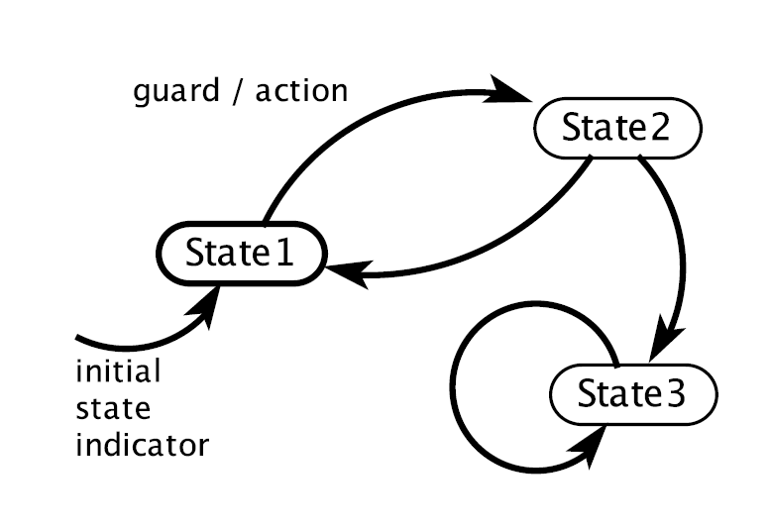
Finite State Machine
Visual notation for a finite state machine
Note: 1. transition condition, or called guard, or called input 2. output, or called action

Slide 23


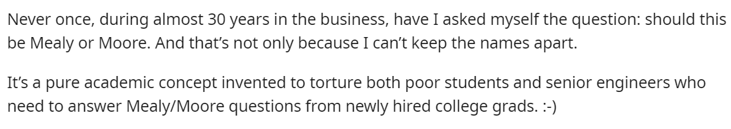
Finite State Machine
Add-on: Mealy Machines and Moore Machines
Some Reddit comments

Slide 24
Finite State Machine
Add-on: Mealy Machines and Moore Machines
George H. Mealy’s paper in 1955: “A method for synthesizing sequential circuits ”
Edward F. Moore’s paper is 1956: “Gedanken-experiments on sequential machines”

Slide 25
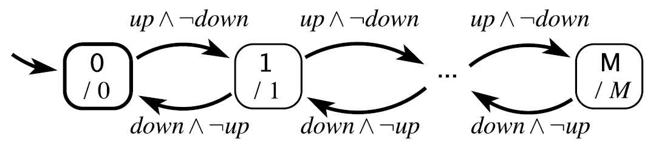
Finite State Machine
Add-on: Mealy Machines and Moore Machines
Mealy Machines: produce output when a transition is taken.
Moore Machines: produce output when the system is in a state.
Note: We will stay with Mealy machines in this class
Note: regular M is the state, italic M is the output.

Slide 26

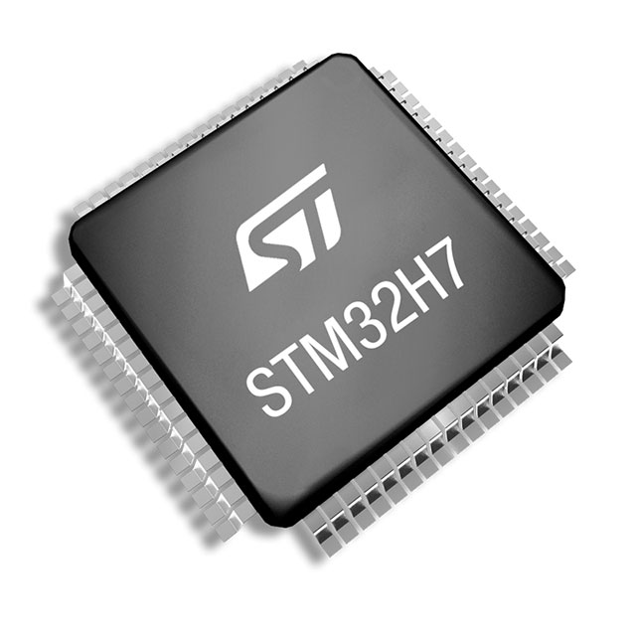
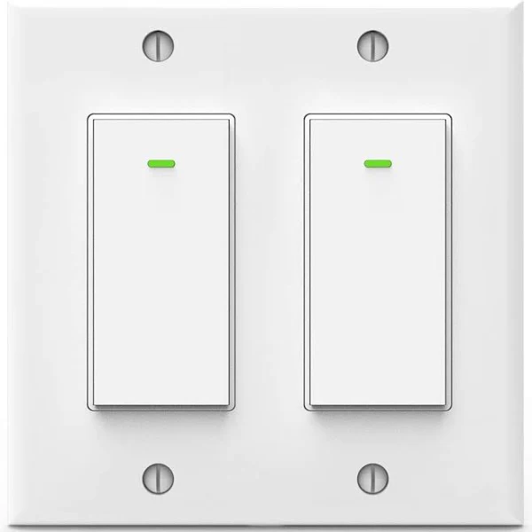
Finite State Machine
Add-on: Mealy Machines and Moore Machines
b
Example: 2 light, 2 button system press any button continuously, light b flashes; press any button once but not the previous situation, light a flashes.
-Press: 0 1 1 0 1 0 0 0
-Flash: a a b a a a b b
light: a b
button: 0 1

Slide 27
Finite State Machine
Add-on: Mealy Machines and Moore Machines
Example: 2 light, 2 button system press any button continuously, light b flashes; press any button once but not the previous situation, light a flashes.
-Press: 0 1 1 0 1 0 0 0
-Flash: a a b a a a b b
light: a b
0/a
0/b
A
B
1/a
1/a
0/a
C
button: 0 1
1/b
Mealy machine

Slide 28
Finite State Machine
Add-on: Mealy Machines and Moore Machines
Example: 2 light, 2 button system press any button continuously, light b flashes; press any button once but not the previous situation, light a flashes.
-Press: 0 1 1 0 1 0 0 0
-Flash: a a b a a a b b
light: a b
0
1
B’
/b
0/a
0/b
0
A
B
A
/-
0
B
/a
1/a
1/a
1
1
0/a
0
C
1
C’
/b
C
/a
button: 0 1
1/b
1
0
Mealy machine
Moore machine
(typically need more states)

Slide 29
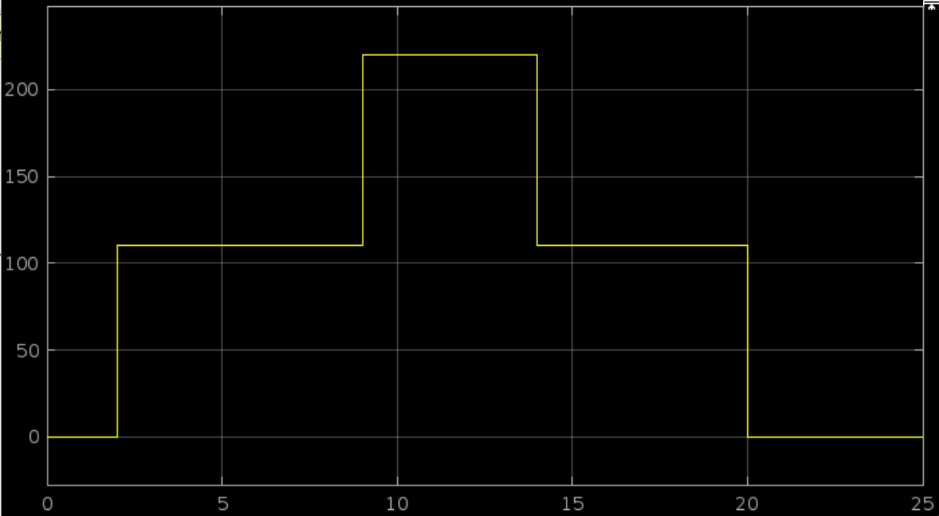
Finite State Machine
How to program it in code?
Example: A special power supply, output different voltages over time
Clock=2s/Voltage=110V
Clock=9s/Voltage=220V
A
B
C
Clock=20s/Voltage=0V
Clock=14s/Voltage=110V

Slide 30
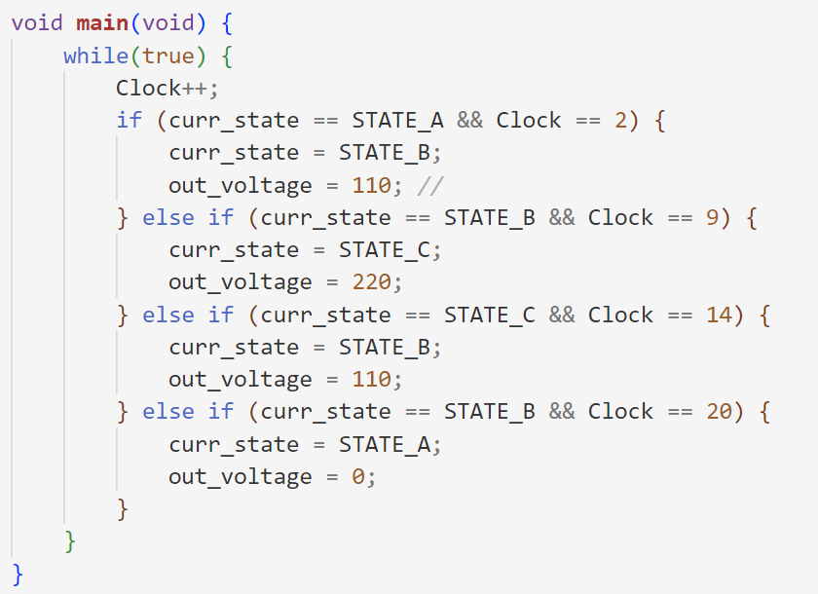
Finite State Machine
Idea 1: Program transition by transition
Clock=2s/Voltage=110V
Clock=9s/Voltage=220V
A
B
C
Clock=20s/Voltage=0V
Clock=14s/Voltage=110V
Each transition as an “if-else” statement.
What if too many transitions?

Slide 31
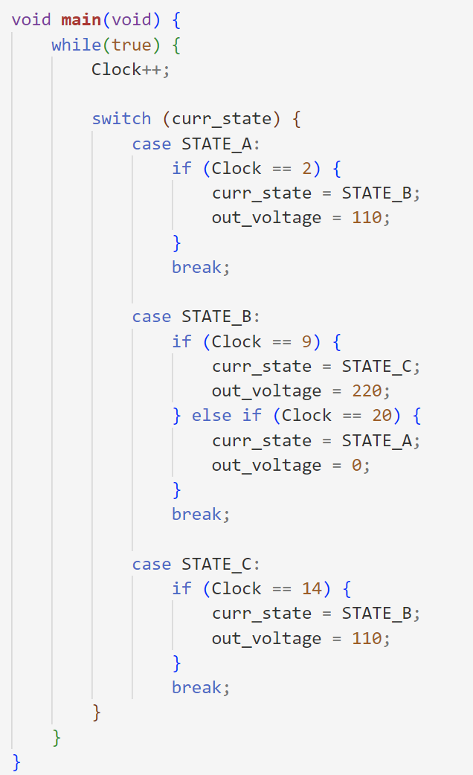
Finite State Machine
Idea 2: Program state by state
Clock=2s/Voltage=110V
Clock=9s/Voltage=220V
A
B
C
Clock=20s/Voltage=0V
Clock=14s/Voltage=110V
Still hard to read or modify?
Any neat way to code?

Slide 32
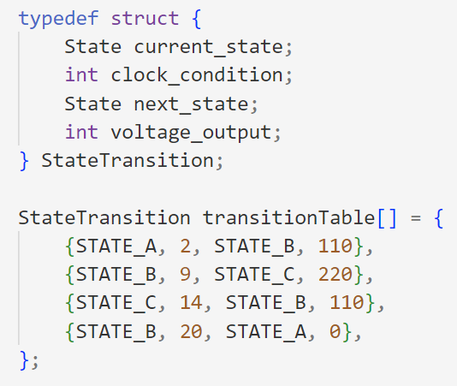
Finite State Machine
Idea 3: Program by state transition table
Clock=2s/Voltage=110V
Clock=9s/Voltage=220V
A
B
C
Clock=20s/Voltage=0V
Clock=14s/Voltage=110V
Current State | Clock Condition | Next State | Output Voltage
STATE_A | 2 | STATE_B | 110
STATE_B | 9 | STATE_C | 220
STATE_C | 14 | STATE_B | 110
STATE_B | 20 | STATE_A | 0
Define a new structure
Everything is in this table

Slide 33
Wrap-Up
Intro to embedded systems
Finite State Machine
Definition
Mealy and Moore
Coding strategy

